Slide 1

DEPARTMENT OF COMPUTER SCIENCE AND ENGINEERING
Project name : Smart Parking
Team name : Proj_224789_Team_3
Team members :
KANIMOZHI V(113321104036)
KARAMSETTY LIKHITHA(113321104038)
KARTHIKA M(113321104039)
KATHIYAYENI S(113321104041)

Slide 2
PROBLEM STATEMENT:
In urban areas, the traditional parking systems are highly inefficient, leading to traffic congestion, wasted time and fuel, increased pollution, and frustrated drivers.
Finding a suitable parking spot is often a time-consuming and stressful experience, exacerbated by the lack of real-time parking availability information.
This inefficiency results in unnecessary fuel consumption, environmental pollution, and revenue losses for parking facility owners.
This system should provide real-time information to drivers, enabling them to easily locate available parking spaces, reserve spots, and make payments, all while integrating seamlessly with existing urban infrastructure.

Slide 3
SYSTEM ARCHITECTURE:
Sensors : In-Ground Sensors: Placed in parking spaces to detect the presence of vehicles. Camera Systems: Utilized for license plate recognition and additional security. Ultrasonic Sensors: Measure the distance between vehicles to optimize space.
Data Communication : Wireless Communication: Sensors transmit data wirelessly using protocols like MQTT or LoRaWAN. Gateway Devices: Collect data from sensors and transmit it to the central server.
User Interface : Mobile App: Allows users to find and reserve parking spaces, make payments, and receive navigation instructions. Web Portal: Provides similar functionalities as the mobile app for users accessing the system via web browsers.
Payment Gateway : Integration with Payment Services: Facilitates secure payment transactions for parking reservations and usage.

Slide 4
Third-Party Integrations : Navigation Systems: Integration with GPS and mapping services to guide users to available parking spaces. City Infrastructure: Integration with traffic management systems for real-time traffic updates and optimal routing. Emergency Services: Access to parking data during emergencies for effective response planning.
Data Analytics and Reporting : Analytics Engine: Processes historical data to generate insights into parking patterns, peak hours, and popular locations. Reporting Tools: Generate reports for parking facility usage, revenue, and trends for strategic decision-making.
Parking Management Dashboard : Administrator Access: Allows parking facility operators to monitor occupancy, manage reservations, and view analytics. Alerts and Notifications: Sends notifications for low availability, reservation confirmations, and payment receipts.
Security Measures : Encryption: Ensures secure communication between sensors, servers, and user devices.Access Control: Implements role-based access control to restrict system access to authorized personnel only.

Slide 5
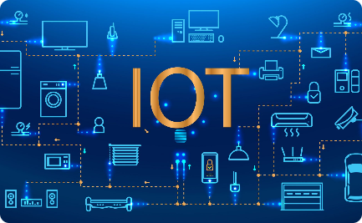

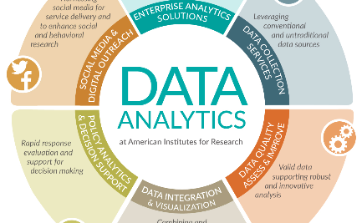
INTEGRATING THE SYSTEM USING IOT TECHNOLOGIES AND PYTHON :
IoT Connectivity
Python Integration
Advanced Analytics
Utilize cutting-edge IoT technologies to connect sensors and devices for accurate parking data.
Leverage the power of Python to develop a scalable and robust smart parking system.
Analyze data collected from the system to gain valuable insights and optimize parking management

Slide 6
WORKING OF SMART-PARKING:
In a smart parking system using IoT technology, sensors placed in parking spaces detect occupancy status.
This real-time data is transmitted wirelessly to a central server through the Internet of Things (IoT) network.
Users can access this information via a mobile app or a web interface, allowing them to find available parking spaces quickly.
Additionally, the system can integrate with GPS services, guiding drivers to the selected parking spot.
IoT-enabled smart meters handle cashless transactions and monitor parking duration, ensuring efficient revenue management.
Machine learning algorithms analyze historical occupancy data to predict future demand, optimizing parking space allocation and pricing strategies.
Smart cameras and security features enhance safety, while automation allows for self-service parking, enabling vehicles to find and occupy available spaces autonomously.
This interconnected network of sensors, data processing, and user interfaces creates a seamless and efficient parking experience, reducing congestion and enhancing urban mobility.

Slide 7
IMPLEMENTATION:
Implementing a smart parking system involves several crucial steps to ensure its efficiency, security, and user-friendliness.
Project Planning and Feasibility Study
Infrastructure Setup
System Development
Integration of Components
User Testing and Feedback
Security Implementation
Deployment
Monitoring and Maintenance
Data Analysis and Optimization
Continuous Improvement

Slide 8
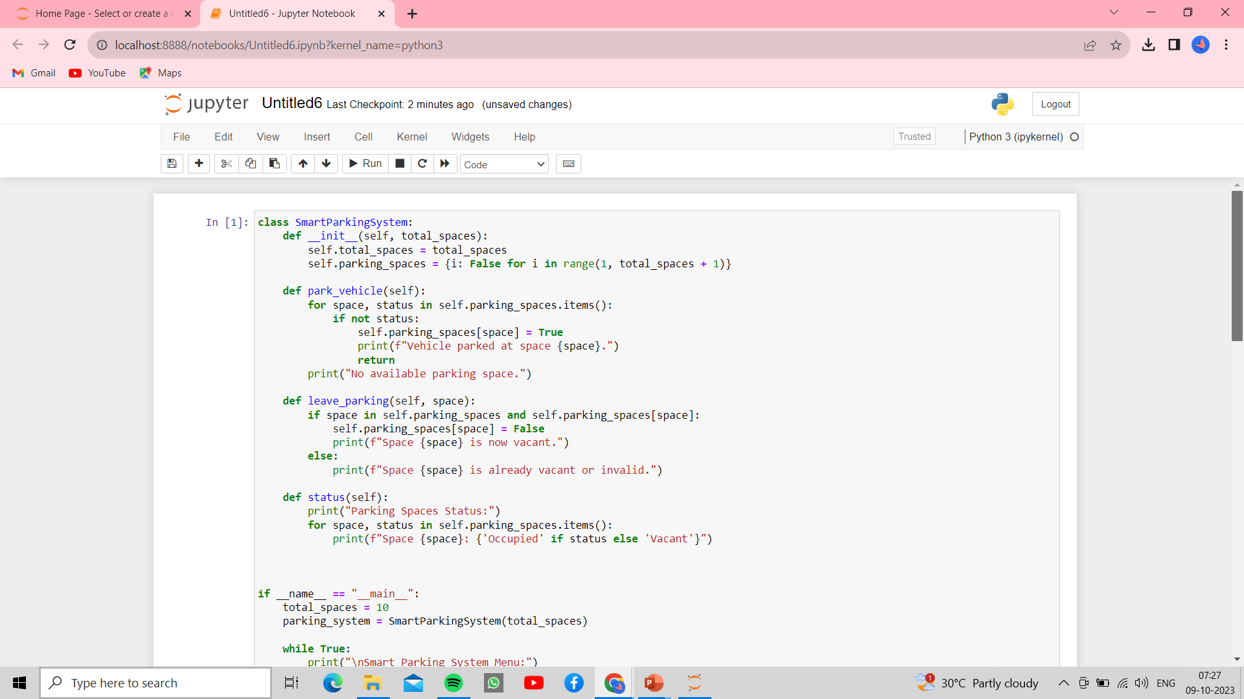
PROGRAM FOR SMART PARKING:

Slide 9
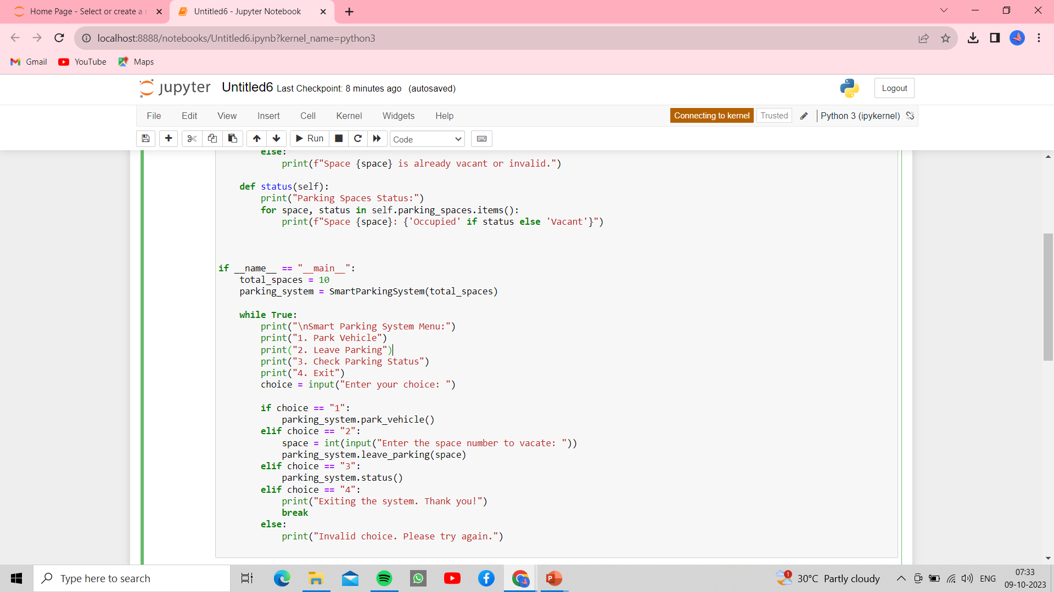
PROGRAM FOR SMART PARKING (CONTINUED):

Slide 10
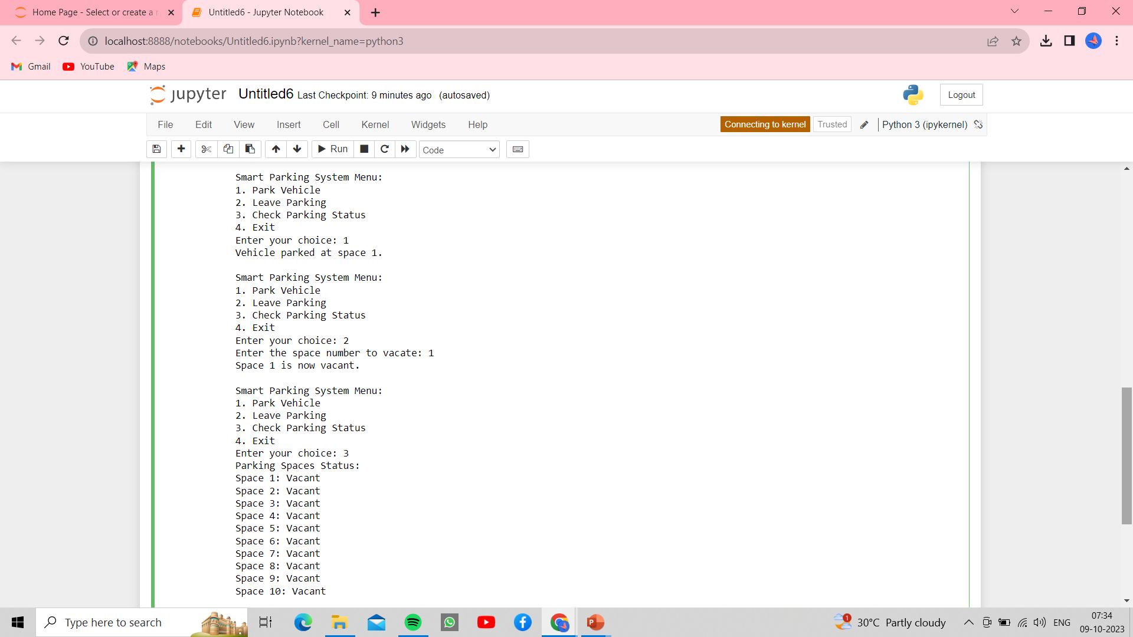
SAMPLE OUTPUT FOR SMART PARKING:

Slide 11
FUTURE ENHANCEMENT:
Future enhancements in smart parking systems leveraging IoT technology will revolutionize urban mobility.
Advanced IoT sensors embedded in parking spaces will collect real-time data on occupancy, enabling predictive analytics and smart algorithms to anticipate parking demand.
Integration with GPS and mobile apps will provide drivers with real-time information on available parking spaces, reducing search time and congestion.
Additionally, IoT-enabled smart parking meters will facilitate cashless transactions and remote monitoring, ensuring efficient revenue management for cities. Enhanced security features, including surveillance cameras and tamper detection, will safeguard parked vehicles and infrastructures.
Machine learning algorithms, analyzing historical data from IoT sensors, will optimize parking space allocation and pricing strategies, enhancing resource utilization and revenue generation. Moreover, IoT-driven automation will enable self-service parking, allowing vehicles to autonomously locate and park in available spaces.
These advancements will not only improve the overall parking experience for drivers but also promote sustainable urban development by reducing traffic congestion, lowering emissions, and optimizing city resources.

Slide 12
THANK YOU!!

